Slide 1
Netflix Data Analysis Project
Prepared by: Sri Tharun Kollu
Duration: 18 July 2025 – 06 August 2025

Slide 2
Executive Summary - This analysis examines Netflix catalog data to uncover content distribution patterns and temporal trends. The study focuses on release year trends, dates content was added to the platform, genre and duration distributions, movies vs TV show breakdowns, country-level content counts, video ratings distribution, and top genres. The findings provide insights useful for content strategy, catalog curation, and user engagement planning.
Objective - To analyze Netflix catalog metadata and identify patterns across time, genres, duration, and geographic distribution. The goal is to provide actionable insights for content acquisition and recommendation strategies.
Dataset Description - The dataset contains metadata for Netflix titles, including fields such as: Order/Index, Title, Type (Movie/TV Show), Director, Cast, Country, Date Added, Release Year, Rating, Duration, and Listed In (genres).
Tools & Technologies Used -
Python – pandas, numpy, matplotlib, seaborn for EDA and visualization
Tableau – interactive dashboards and storyboards
Excel – quick pivot checks and summaries

Slide 3
Key Focus Areas & Findings
1.Release Year Trends - The catalog shows concentration in recent decades with spikes corresponding to years of heavy content production. Older release years are present but often represent classic or legacy titles added for catalog depth.
2. Date Added Patterns - Date-added timestamps reveal regular cadence of content additions with periodic bulk uploads tied to licensing/partnership deals or platform expansions. Seasonal patterns in additions may align with strategic launches (e.g., summer releases or end-of-year content drops).
3.Genre Distribution - Certain genres (e.g., Drama, Comedy, Documentary) dominate the catalog, while niche genres have smaller but loyal audiences. Multi-genre titles are common; splitting 'Listed In' into atomic genres helps reveal true genre frequencies.
4.Duration Analysis - Movies typically cluster around feature-length durations (80–140 minutes), while TV shows show episode-duration patterns and season-length variation. Duration insights assist in recommendation optimization and content placement for user sessions.

Slide 4
5. Movies vs TV Show Distribution - The catalog contains both movies and TV shows; distribution often favors one type depending on licensing trends. Understanding the mix helps tailor marketing and UI surfacing for binge-oriented vs single-view audiences.
6. Total Movies and TV Shows by Country - Country-level aggregation highlights countries that contribute most titles; large production hubs and English-speaking markets typically lead. Local-language content growth is visible over recent years as Netflix expands regional offerings.
7. Video Rating Distribution - Rating distributions (e.g., TV-MA, PG-13, R) show the platform's audience suitability mix. Many catalogs skew toward mature audiences, but family-friendly and children's programming remain significant.
8. Top 10 Genres & Yearly Counts - Identified the top 10 genres by title count to surface where catalog depth is strongest. Yearly counts for movies and TV shows reveal production and acquisition trends over time and help spot growth in specific genres

Slide 5
Conclusions & Recommendations - Use release-year and date-added patterns to inform content curation strategies and retarget promotions for timely titles. Invest in genres with strong catalog depth and growth potential while piloting niche genres through targeted marketing. Leverage duration and type distribution to improve recommendation models—e.g., promote shorter titles for mobile users and binge-able TV shows for weekend campaigns. Expand regional content where country-level counts indicate unmet demand to improve subscriber growth in those markets.
Limitations & Next Steps - The analysis depends on metadata completeness; missing or inconsistent country and genre fields reduce accuracy. Next steps include sentiment/review analysis (if ratings or user feedback available), watch-time correlation, and recommender-system experiments.
Appendix - Suggested Visuals - Release Year histogram Date-added time series (monthly) Genre bar chart and sunburst of multi-genre titles Duration distribution (movies vs TV shows) Stacked bar: movies vs TV shows by year Choropleth or bar chart: titles by country Rating distribution pie or bar chart Top 10 genre table with counts
Deliverables - A Tableau workbook containing the above dashboards (if desired). Python scripts/notebook for the full ETL and EDA pipeline. This PDF report summarizing findings

Slide 6
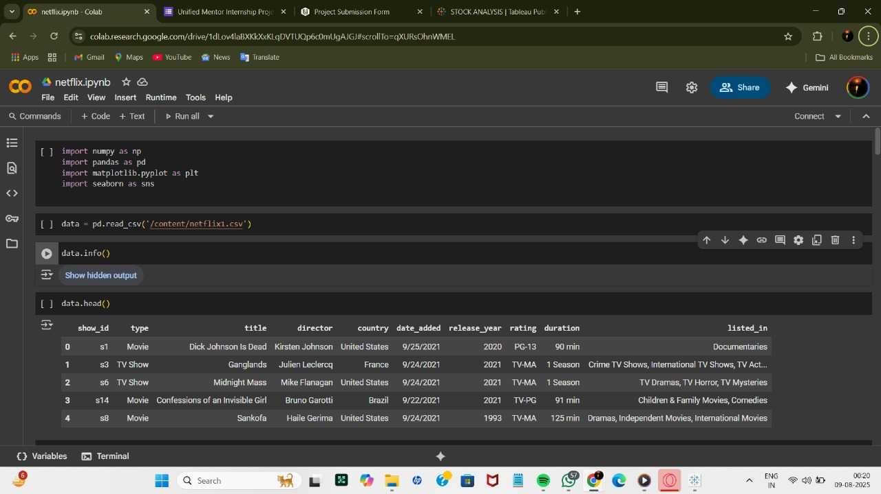

Slide 7
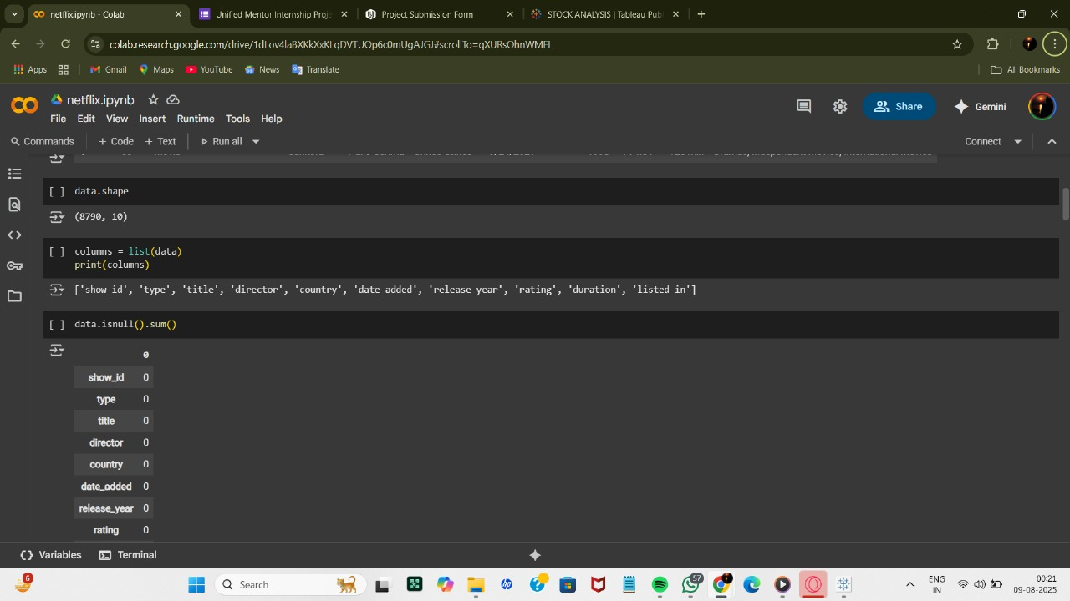

Slide 8
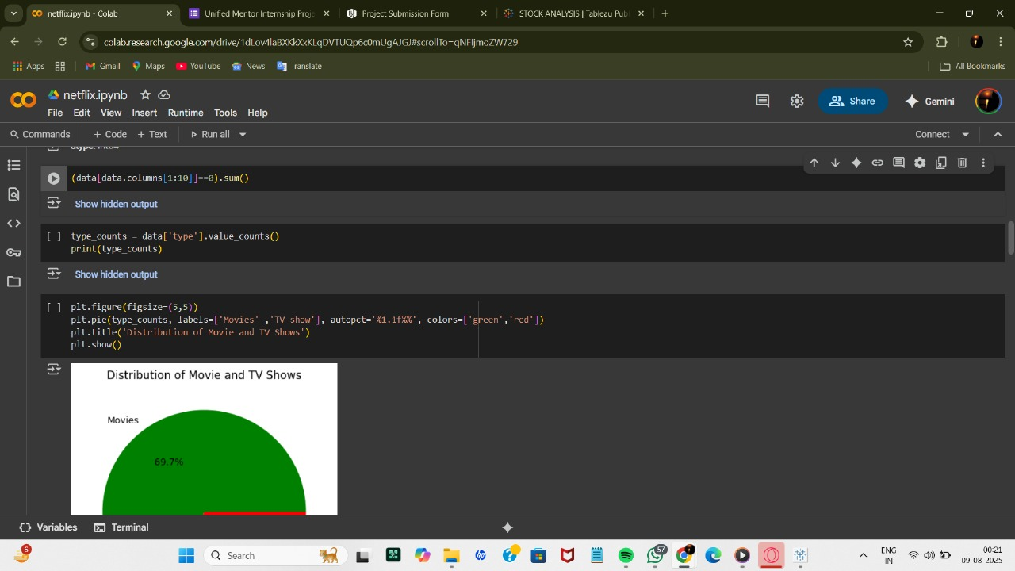

Slide 9
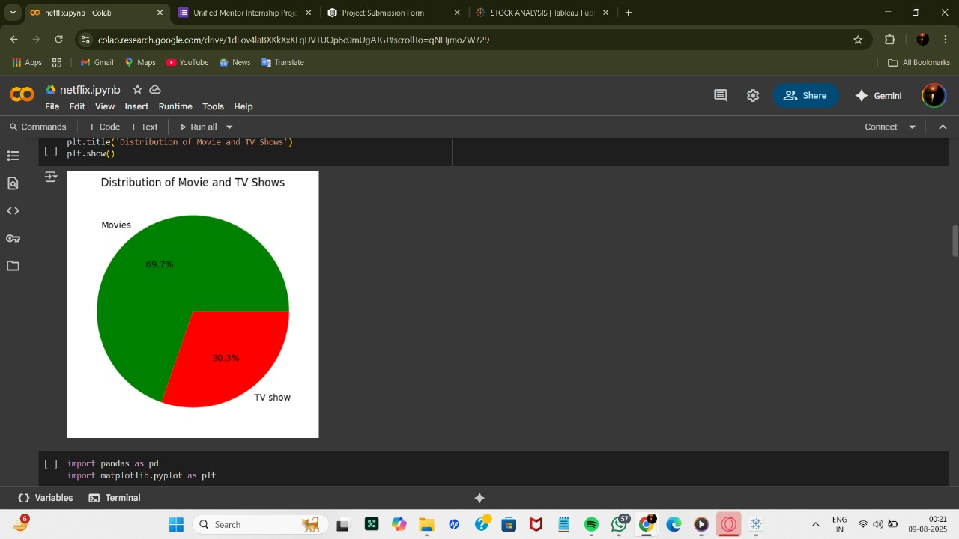

Slide 10
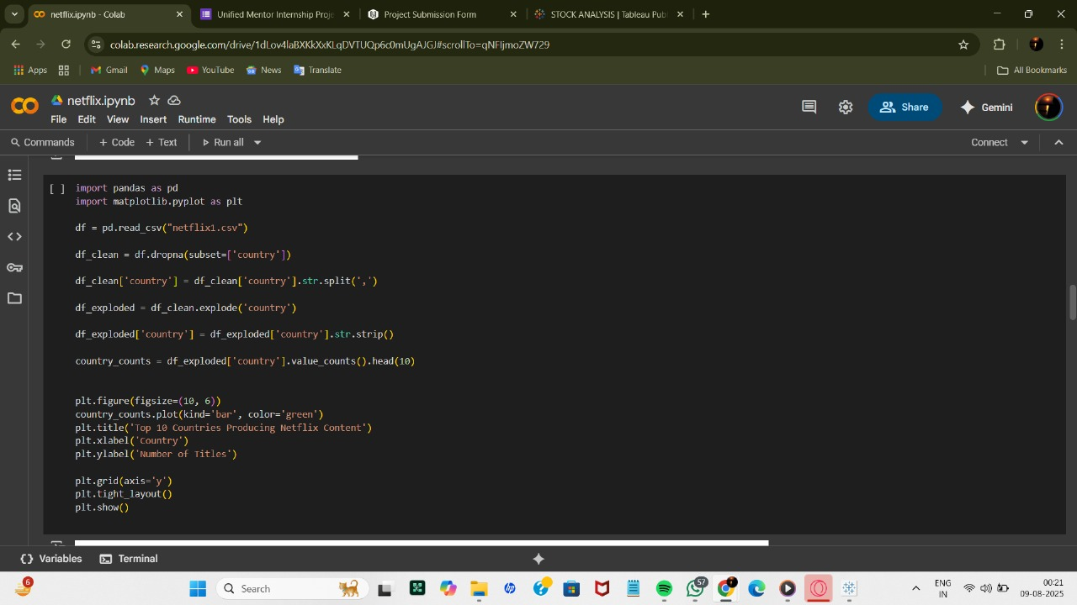

Slide 11
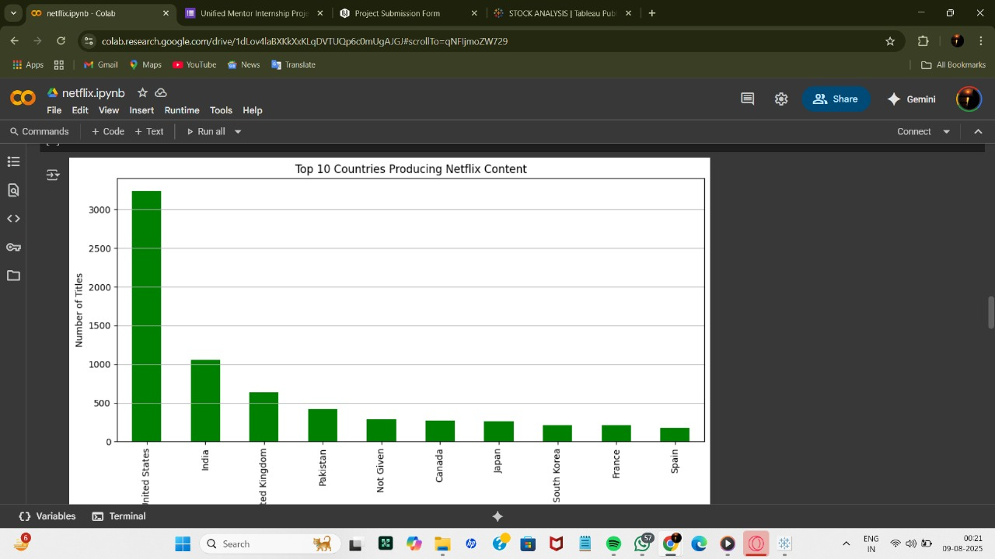

Slide 12
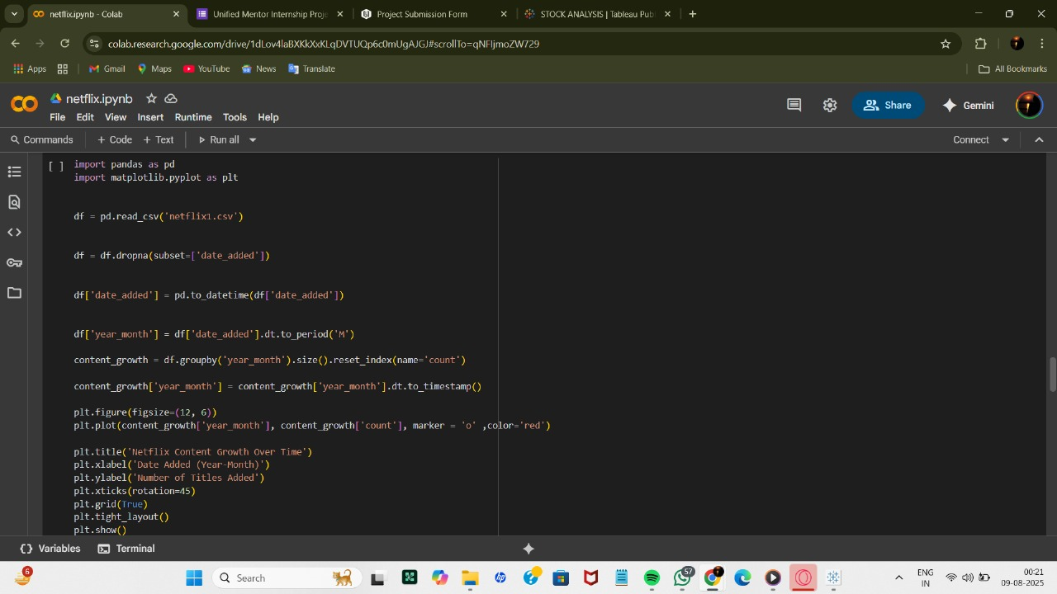

Slide 13
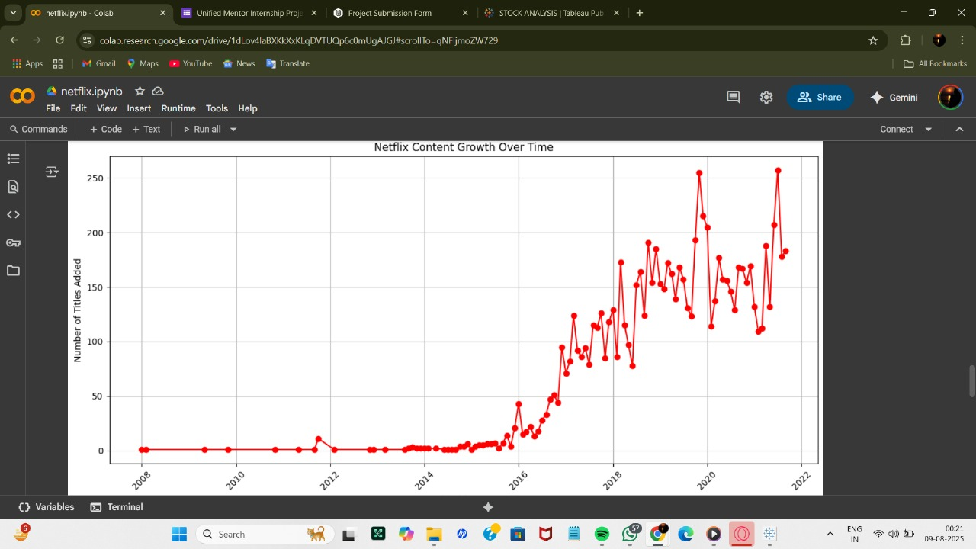

Slide 14
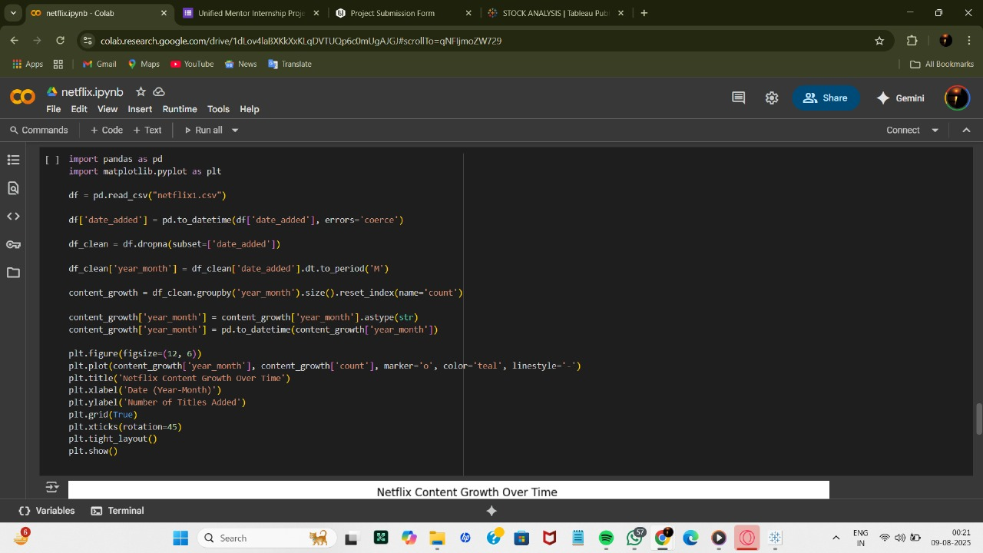

Slide 15
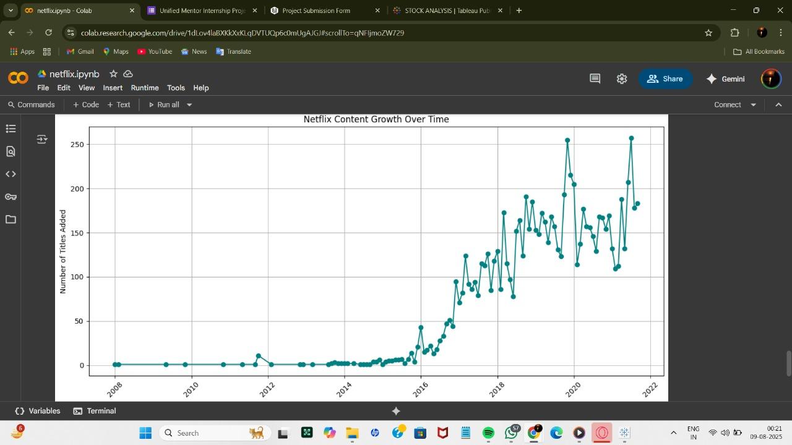

Slide 16
